Slide 1

Team name: Team Aztecs
Smart container for cold storage
Saudagar Nikhath Afreen
Namira Tabassum
IBM HackChallege 2020

Slide 2

PROBLEM STATEMENT
To design a smart container for cold storage that detects the state or condition of stored food products for better productivity.
The main objective of this prototype is to examine the stored food product and give a response to the user/customer as to whether it is still edible or has become rotten.
IBM HackChallege 2020

Slide 3
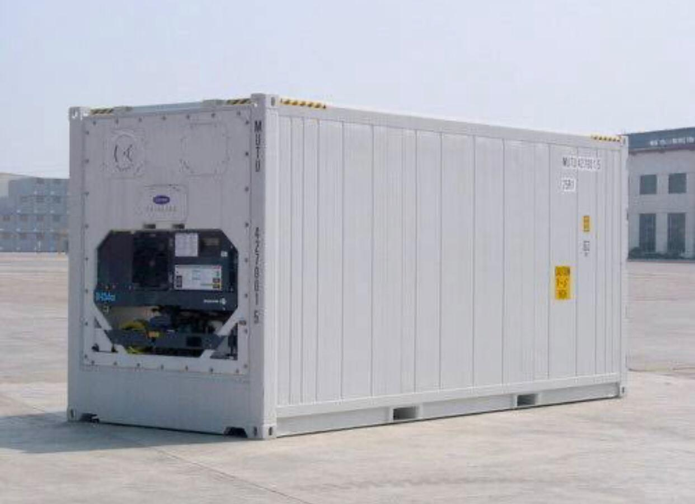
EXISTING SOLUTIONS
Such smart containers available commercially are known as Reefers , they make an excellent, portable solution for short or long term storage and can be used to ship or truck goods over long distances as they can be plugged into the power station on ships or have clip on generators attached. Approximate price-Rs 550,000
They provide:
SU AA broad temperature range
Versatile airflow
Highly portable
IBM HackChallege 2020

Slide 4
OUR SOLUTION
We have designed a prototype that detects food items based on visual recognition of the specific item i.e. it examines the provided food item and compares it to the images specified in the database.
If the stored food item matches any of the images present in the database/class , it returns a statement which states whether the food item is edible or stale .
IBM HackChallege 2020

Slide 5

TECHNOLOGY
This prototype is based on the technology associated with IOT i.e Internet Of Things, which is a system of interrelated computing devices , mechanical and digital machines , objects , animals or people that are provided with unique identifiers and the ability to transfer data over a network without requiring human –to-human or human-to-computer interaction.
In simple words , IOT is used to simplify the network of interconnected devices which are embedded with sensors ,software and network connectivity that enables them to exchange data.
IBM HackChallege 2020

Slide 6
PRODUCT HARDWARE
The smell detection of the prototype is designed using Arduino UNO, which is based on Embedded Systems.
List of components :
Gas sensor-This sensor detects smell i.e when it is sprayed on for representational purposes.
Buzzer- This is used to sound an alarm when the sensor detects a smell.
Arduino board-This is the main equipment used for making the prototype , it is programmed by Arduino UNO which is a combination of Python and C sharp.
IBM HackChallege 2020

Slide 7

PRODUCT SOFTWARE
The prototype was designed using visual representation services provided by IBM cloud studios .
IBM cloud computing is a set of cloud computing services for business offered by the information technology company IBM. It includes infrastructure as a service, software as a service and platform as a service.
IBM Watson Studio is a leading data science and machine learning platform . It helps enterprises speed data exploration and model development and training .
IBM HackChallege 2020

Slide 8
DESIGN AND DEVELOPMENT
The first step to design this prototype began with creating an account on IBM.cloud.com in order to access the services of the studio and create a class or database for visual representation.
If time permitted then we would add a feature such that the prototype displays the expiration date , stored date and the category to which the stored food item belongs to .
We make the interface user friendly such that anyone would be able to access it without having prior knowledge on how to use IBM cloud studio.
IBM HackChallege 2020

Slide 9
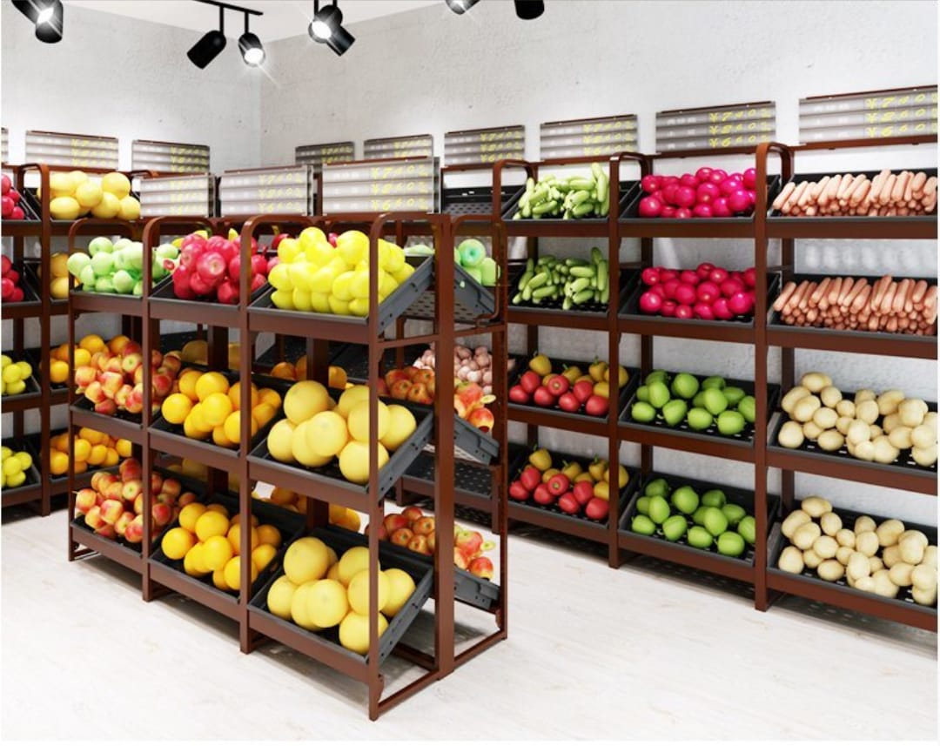
RESULTS
It is a model to help farmers with the storage of their harvest before it is shipped or sold .
It also detects foul odour of stored produce and alerts the owner before the stored food item decomposes completely , thereby preserving the value of the stored food items.
IBM HackChallege 2020

Slide 10
If you want to purchase/sponsor our solution/product, just mail us to teamaztecs@gmail.com We are happy to hear your feedback as well, we would come back stronger!
THANK YOU!
IBM HackChallege 2020

